Slide 1
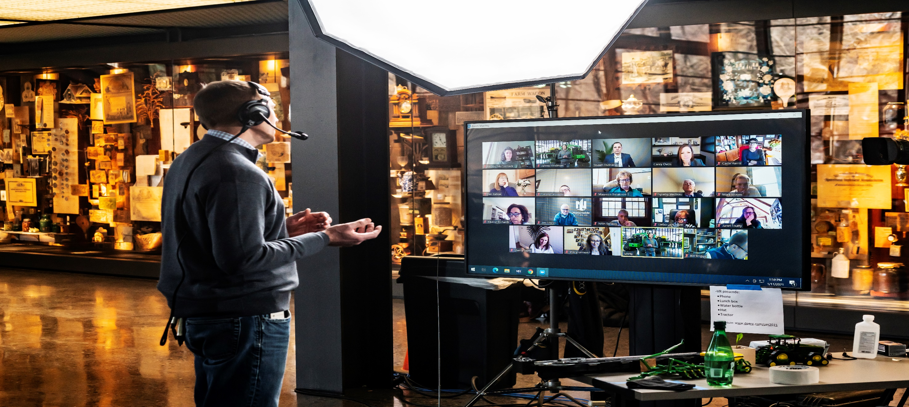
Technology Exploration – FY2024 GenAI Video Bot
Hrushikesh Chavan
Rajkumar Sawant
Wasim Shaikh

Slide 2
Problem Statement
John Deere customers and technicians often rely on traditional repair manuals and PDF documents to perform maintenance and repair operations on their equipment.
These documents, while valuable, may not always be user-friendly or easily accessible during hands-on work.
Challenges:
Complexity of Information:
Repair and service manuals can be dense and technical.
Lack of Visual Aid:
Static images in PDFs do not convey the dynamic nature of certain repair procedures.
Accessibility Issues:
Technicians in the field may have limited access to printed manuals or electronic devices that can read PDFs..
Time-Consuming Process:
Referring back and forth between text and images in a PDF is time-consuming.

Slide 3
Objective
The primary objective of this project is to develop a series of repair and service videos utilizing Generative AI, transforming Deere-specific information and manuals into comprehensive, step-by-step visual guides. These videos aim to:
Enhance User Experience
Ensure Correct and Safe Procedures
Improve Efficiency
Increase Accessibility
Leverage AI Technology

Slide 4



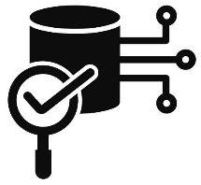

Milestones
Technology Exploration
Solution Definition and Analysis
Data Acquisition
Solution Architecture / Execution
Documentation and Closure

Slide 5
Technology Exploration
SORA
GPT-4 Vision Preview
GPT-4O
Dall-E
Gemini Vision
Stable-video-diffusion-img2vid
https://lancedb.github.io/lancedb/
https://platform.openai.com/docs/introduction
https://platform.openai.com/docs/overview
Tune-A-Video: One-Shot Tuning of Image Diffusion Models for Text-to-Video Generation (thecvf.com)

Slide 6
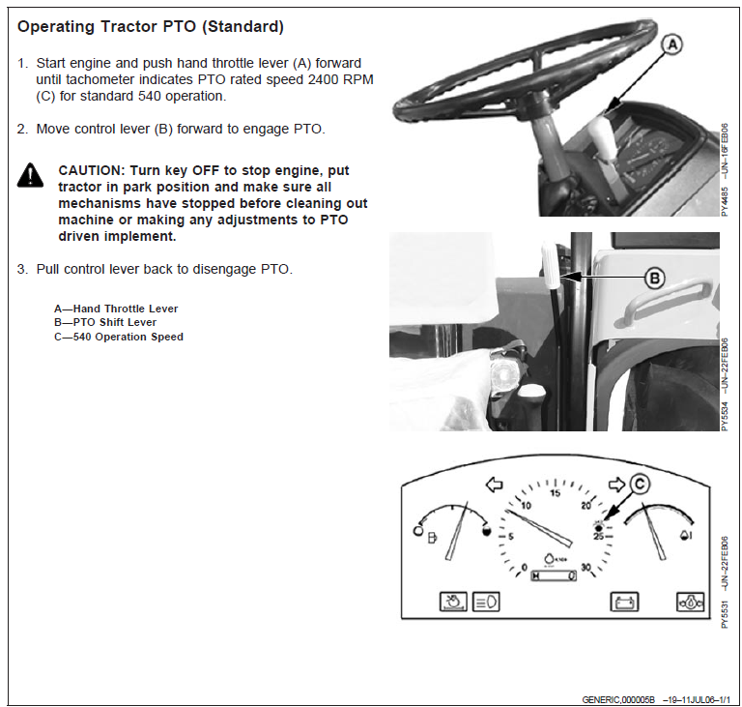
Sample Repair Manual:
OPERATOR’S MANUAL 5310 S Tractor
Challenge:
Need to read through multiple text pages
Difficult to understand the sequence of operations
Lacks visual appeal

Slide 7
Models
Model Name | Open Source/Paid | Model Type | Capability
SORA | Not Available | Video | NA
GPT-4 Vision Preview | Paid | Vision/Image | Text to Image
GPT-4O | Paid | Multimodal | Text to Image + Language
Dall-E | Paid | Vision/Image | Text to Image
Google Gemini (Vision) | Free | Multimodal | Text to Image
Stable-video-diffusion-img2vid | Open Source | Multimodal | Image to Video
Notes:
Stress on why we used open-source models
Every language has different models

Slide 8
Challenges:
1. GenAI video generators requires sequence of Images showing the action to create the Video
Challenge: Current JD manuals does not have sequence of images to show the operation
2. GenAI image generator can create sequence of images
Challenge: The image generator are not able to create images for JD machines/ JD context
3. GenAI video generator requires video training data set for fine tuning to specific task
Challenge: Currently, no such training/ fine tuning video dataset for JD is available

Slide 9
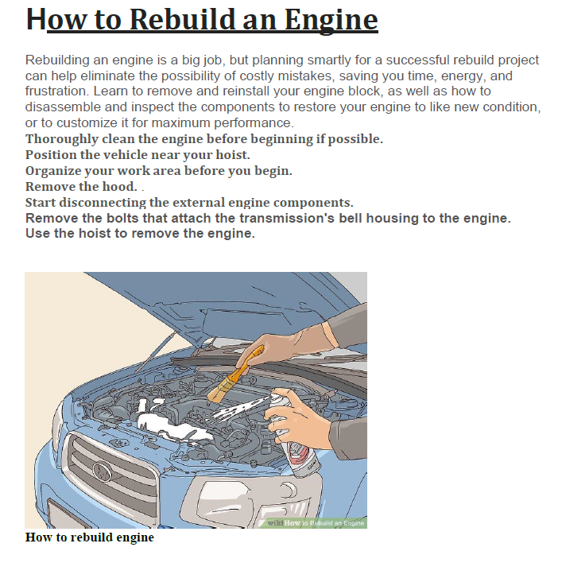
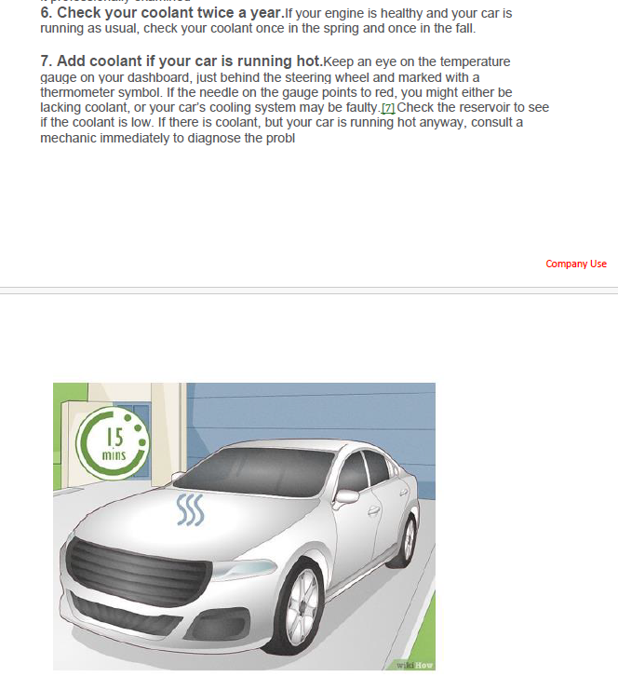
Approach
Dataset Creation:
Repair Manual with sequence of images showing action.
Methodology:
Extract contextual images and text based on user query from the data. Create video from the images and text extracted from the Manual

Slide 10





Solution Architecture and Execution
Extract Images from PDF
MultiModel + Embeddings
Vector DB – Lance DB
(Image + Text) Embeddings
Repair Manual
( PDF file with images and Text)
Extract Text from PDF
MultiModel + Embeddings
MultiModel + Embeddings
User Query
Solution text in Sequence of Operation format
Text to Audio
(gTTS library)
Create Repair Video
Solution:
Sequence of Operations
Extract Images
Create video using Images and Text
Solution images in sequence of Operation format

Slide 11
Tools and Libraries
Process | Library/ Model used
Image Extraction from PDF | PikePDF
Text Extraction from PDF | PyPDF2
Create Application for solution | Streamlit
To Store encoding of Image and text | LanceDBVectorStore
Encoding | gpt4O
Text to Audio | gTTS
Images to Video | OpenCV
Video-Audio merging | Subprocess

Slide 12
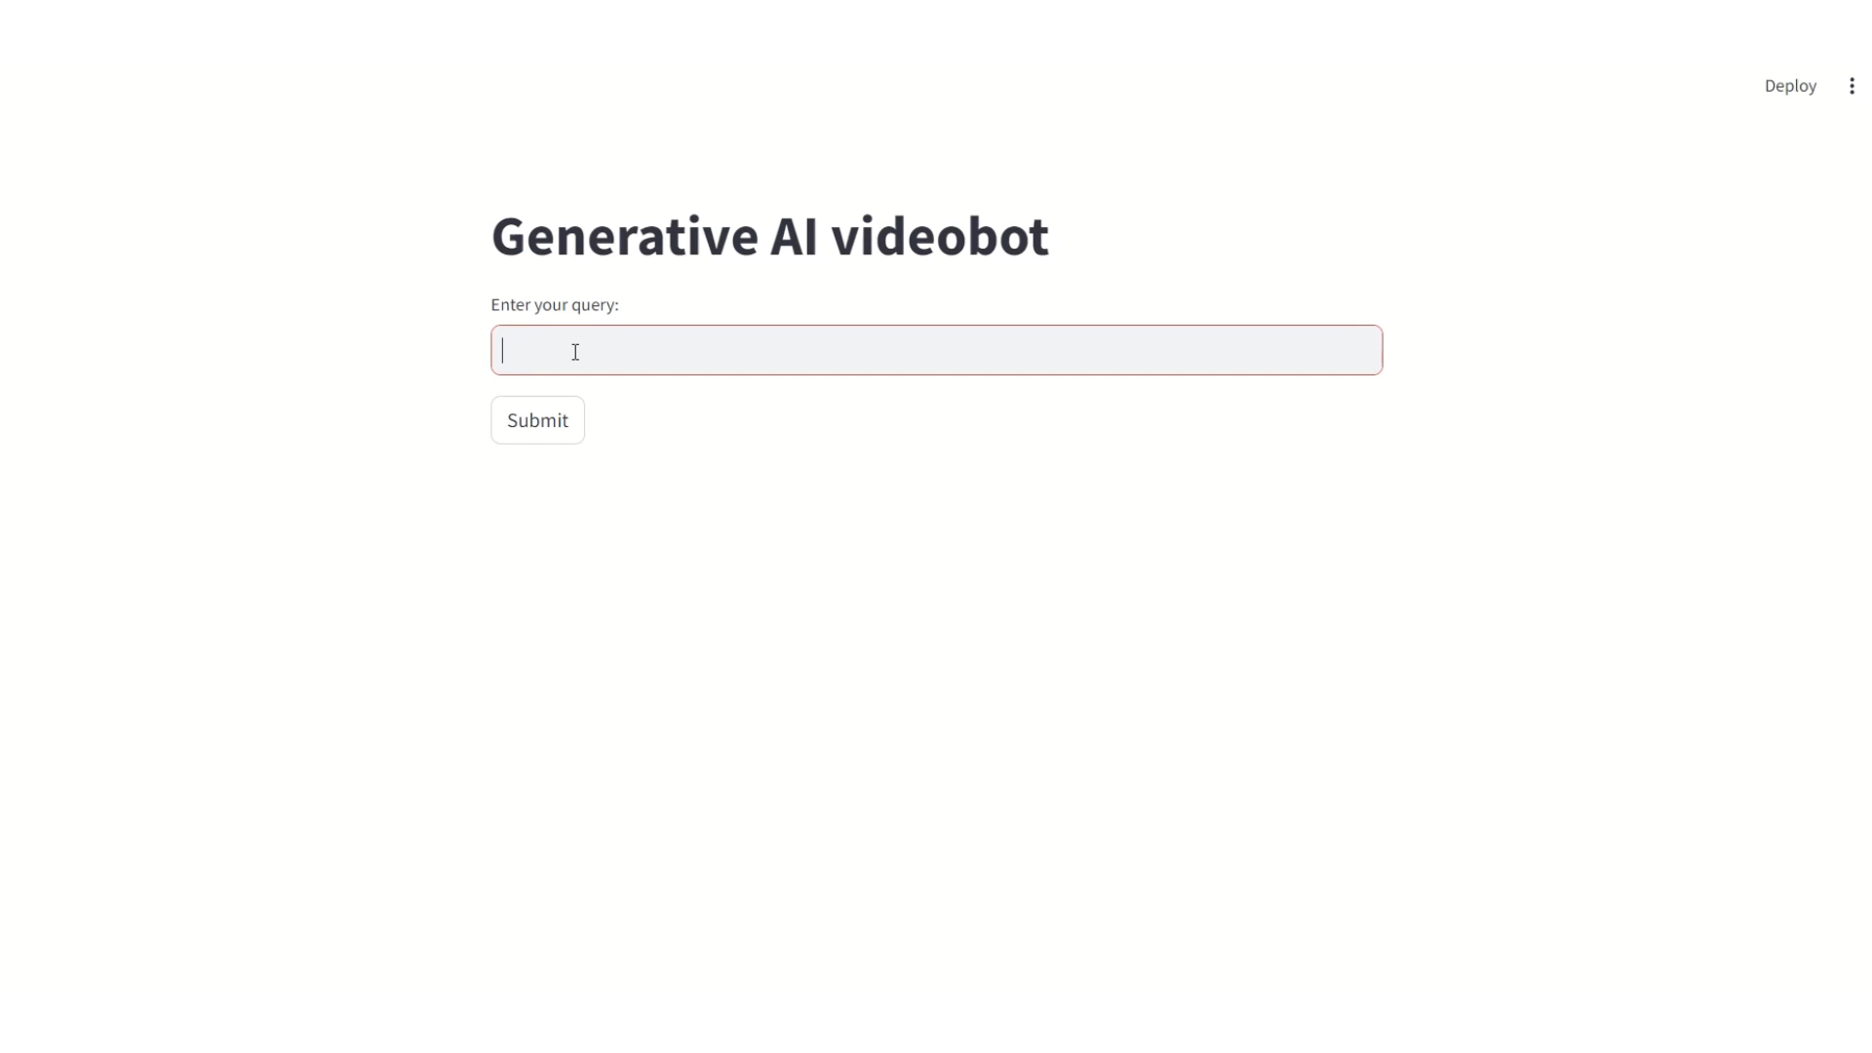
Demo

Slide 13
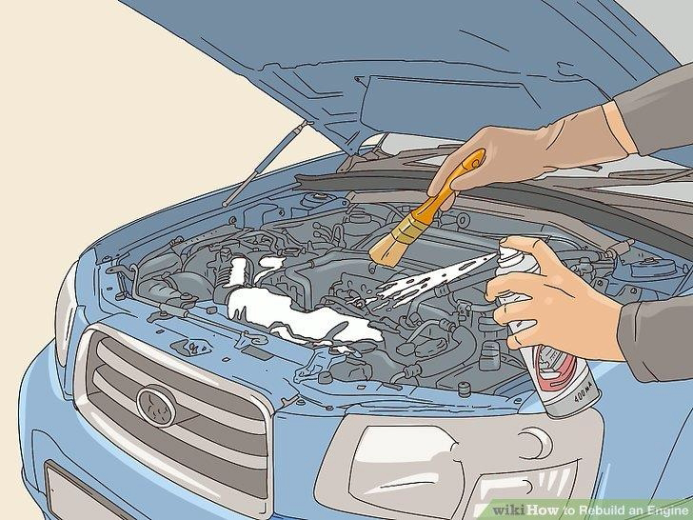
Demo

Slide 14
Limitations of current work
Solution works when there are tagged images showing action sequence.
Can not create video when only one image is used to explain action.
Sometimes sequence of images shuffles due to image embedding.

Slide 15
Way Forward
Image to text tagging
Explore further image and video creation model as and when models are available
Improve audio and image sync logic.

Slide 17
